Slide 1
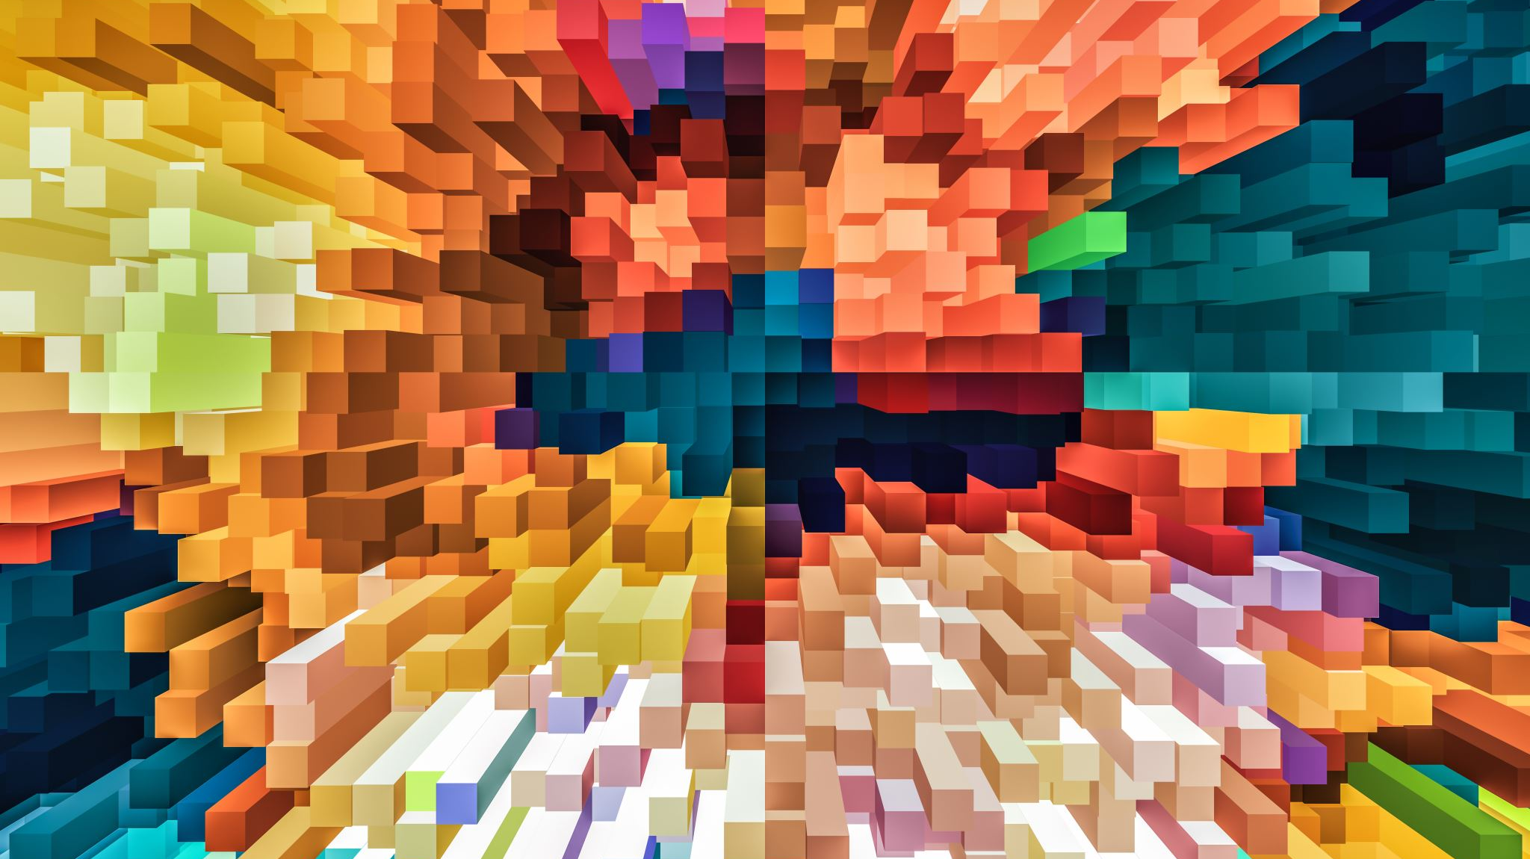
Progress Pitch
Week 4

Slide 2
Papers
Fast, Parallel, GPU-based Construction of Space Filling Curves and Octrees
High Resolution Sparse Voxel DAGs
SSVDAGs: Symmetry-aware Sparse Voxel DAGs
Efficient Animation of Sparse Voxel Octrees for Real-Time Ray Tracing

Slide 3
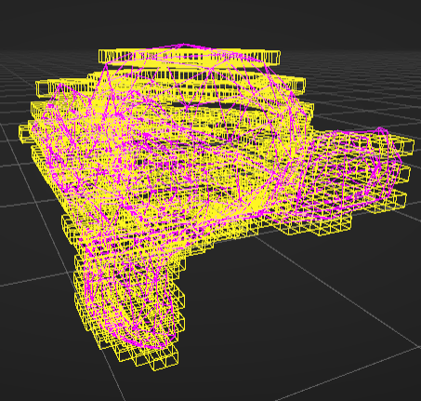
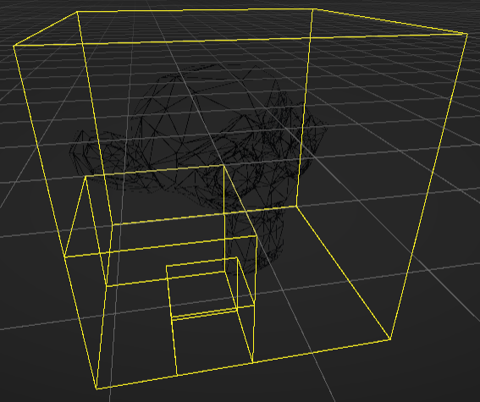
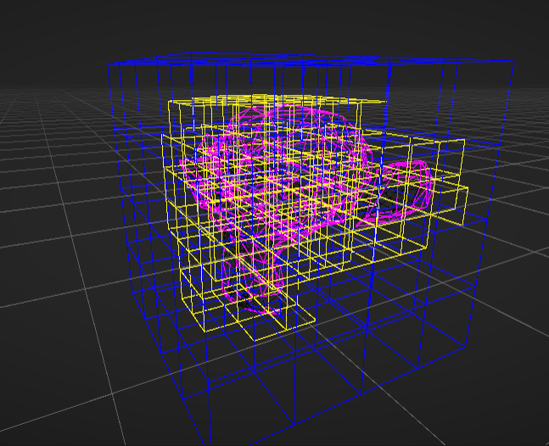
GPU SVO voxelization

